Slide 1
Introduction to Bioinformatics
In the name of the most high
Proteins
Ali Sharifi-Zarchi
Department of Computer Engineering, Sharif University of Technology
The contents including images and videos are from Bruce Alberts et al. Essential Cell Biology,
unless indicated separately.
These slides are available under the Creative Commons Attribution License.

Slide 2
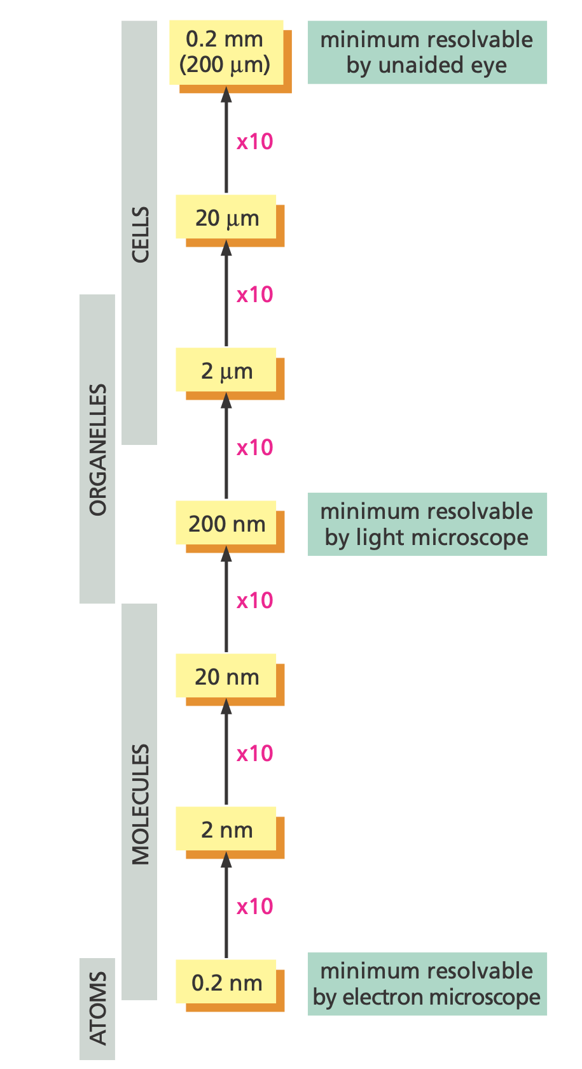
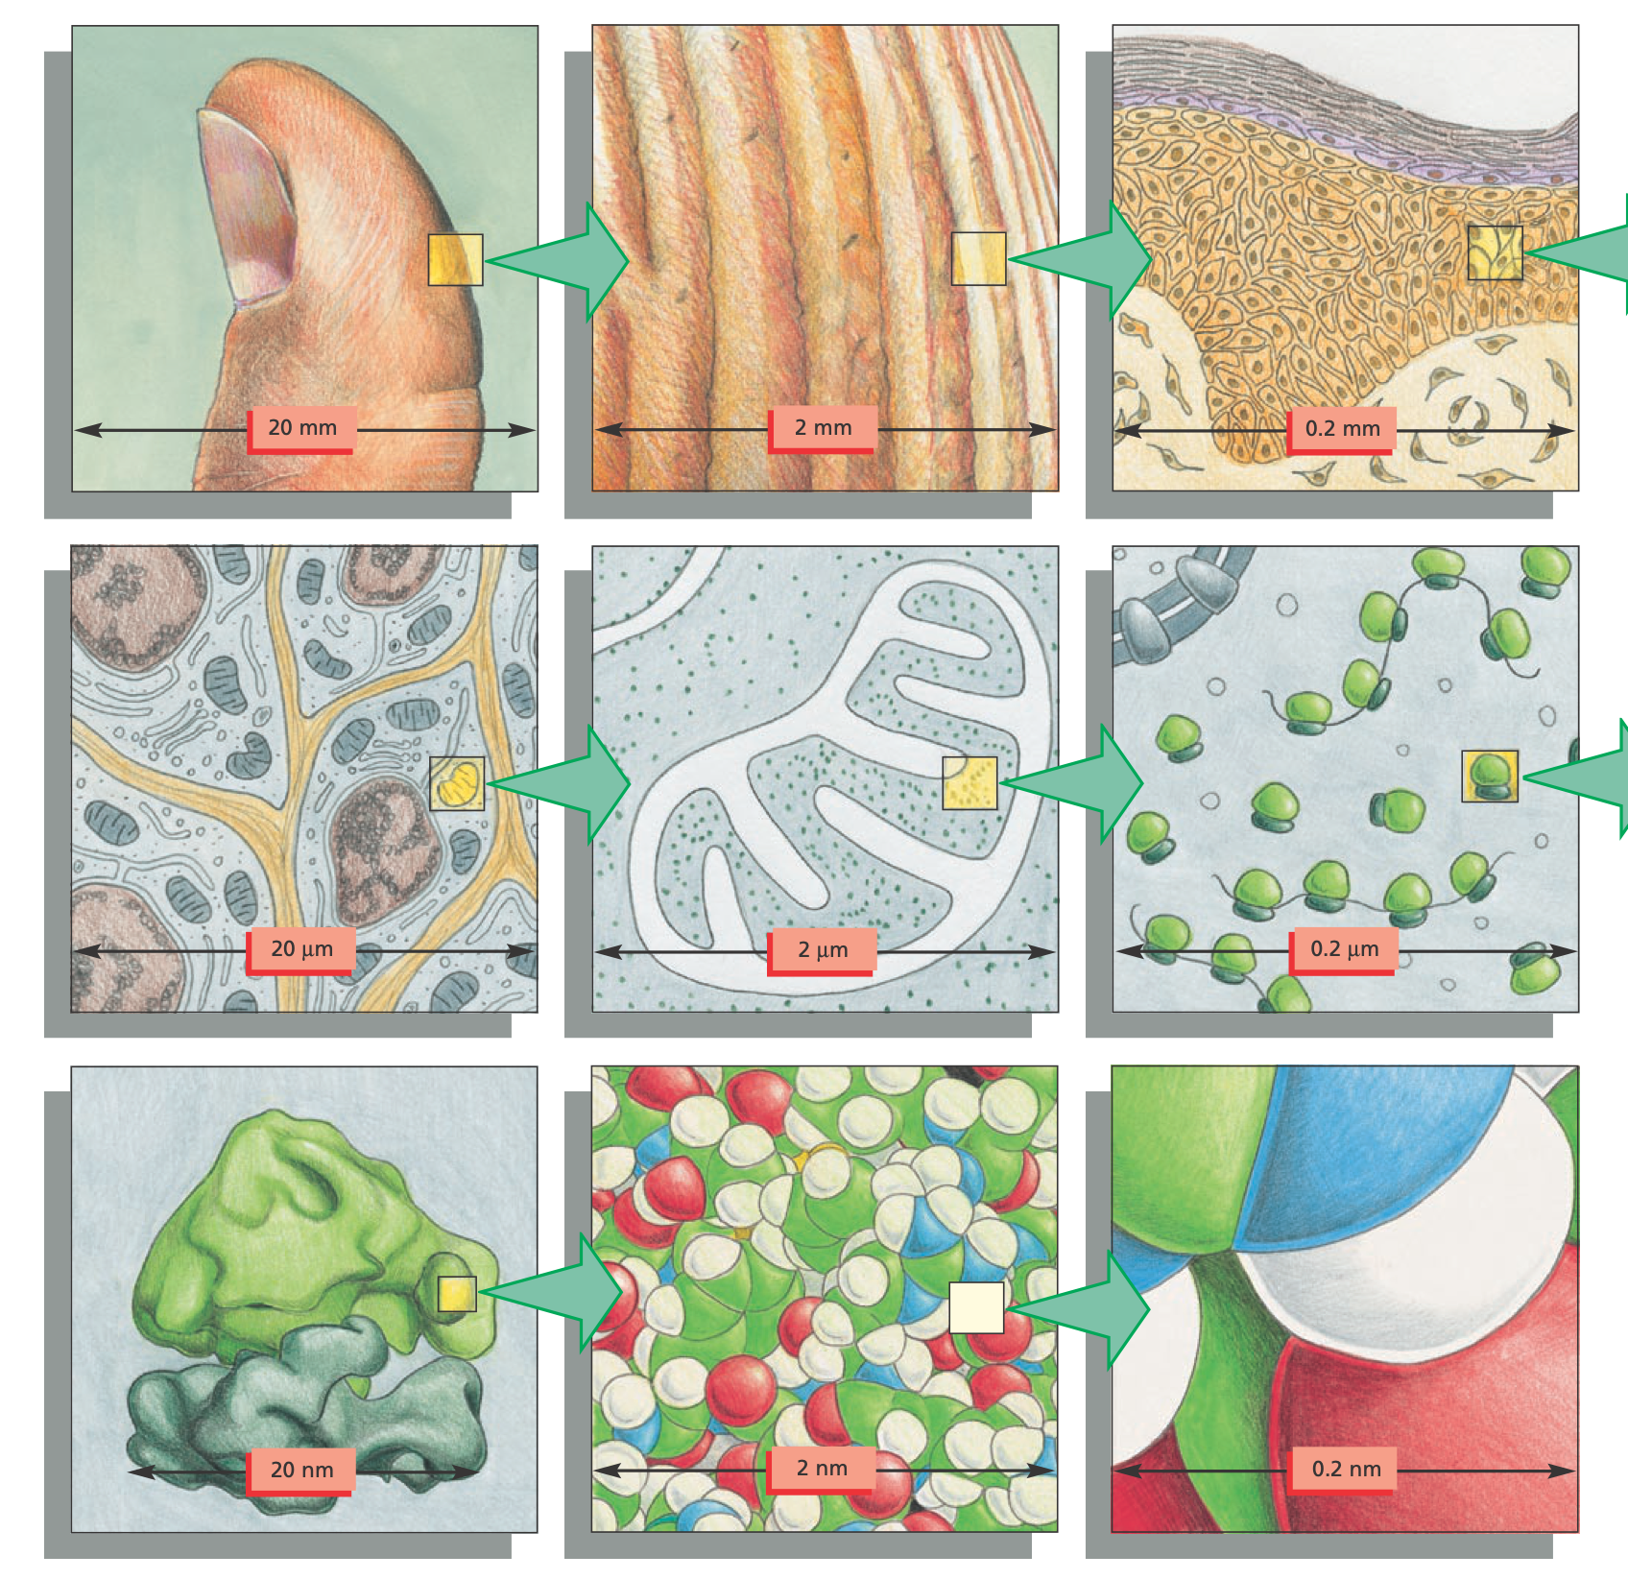
What can we see?

Slide 3
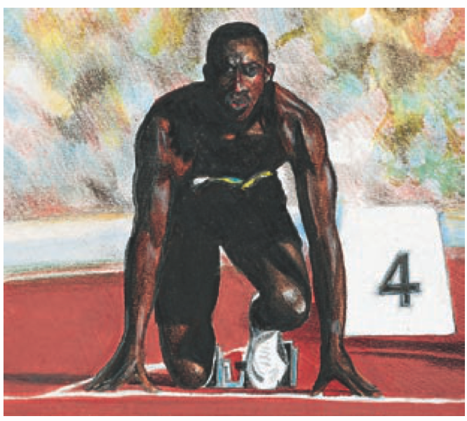
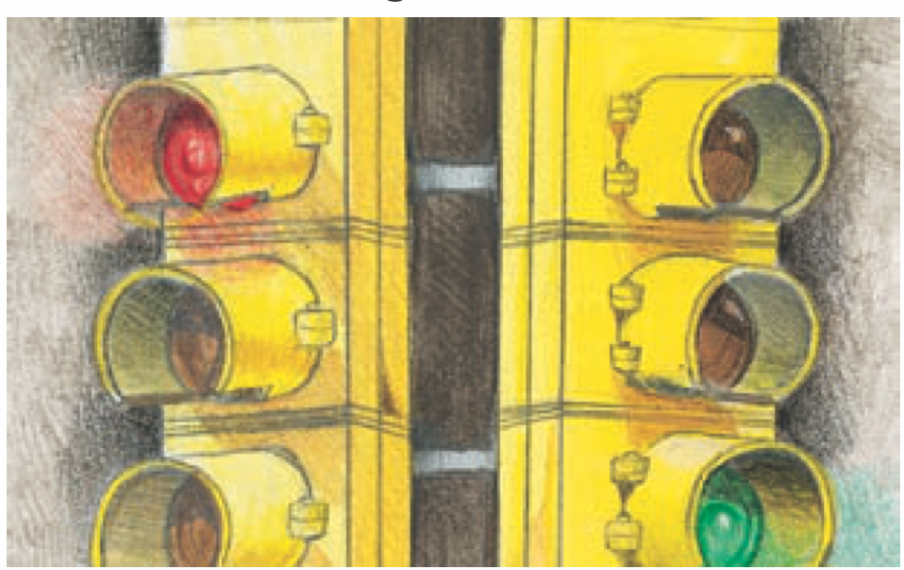
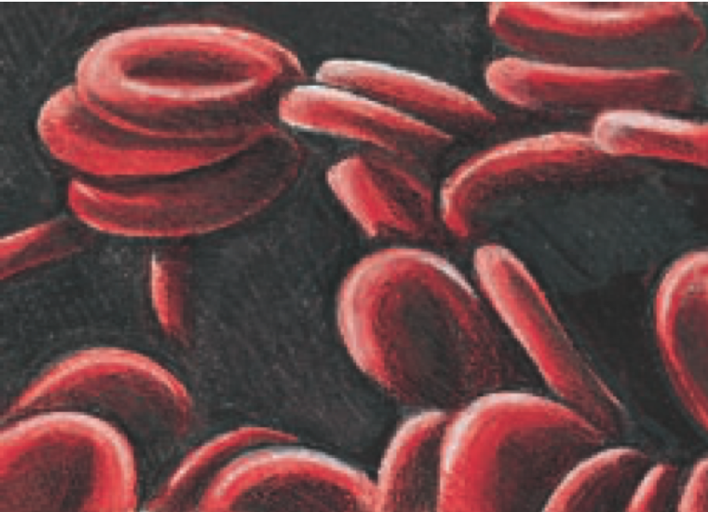
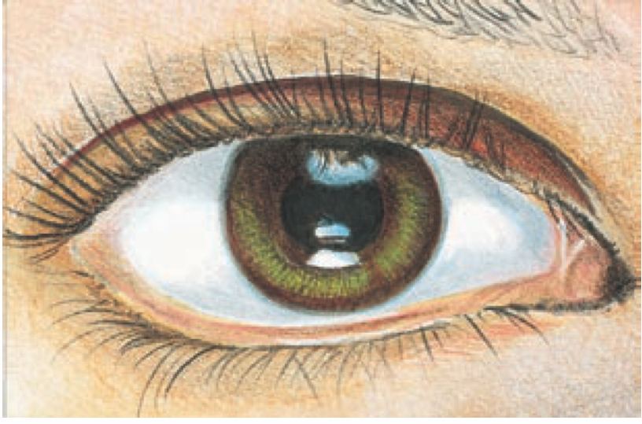
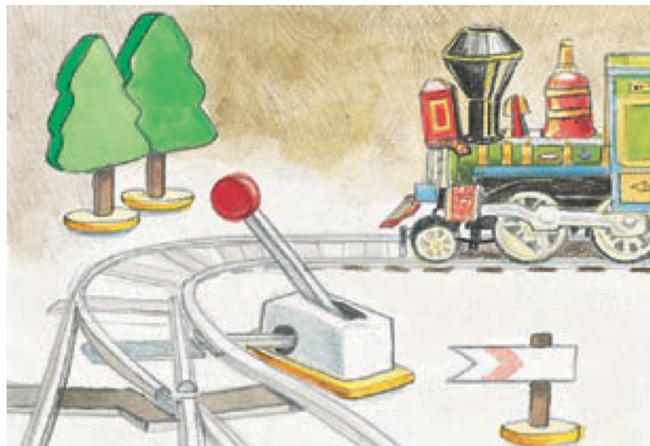
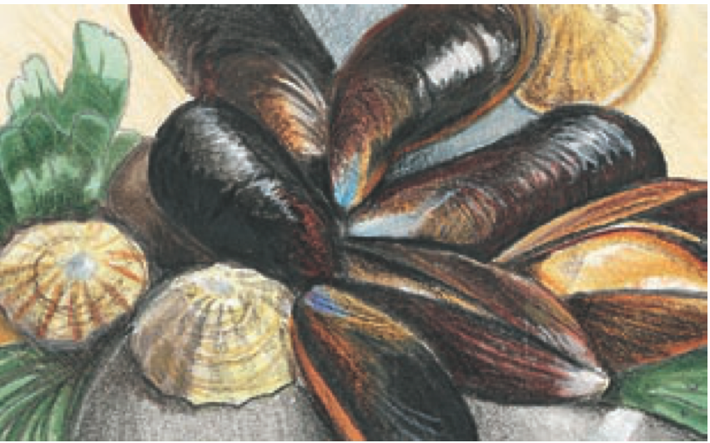
How our body can do such wonderful things?
Notes:
Motor, Signal, Transport, Receptor, Regulatory, Special Function, Enzyme, Structure, Storage

Slide 4
Proteins
http://tower.life/wp-content/uploads/2016/06/protein700.jpg

Slide 5
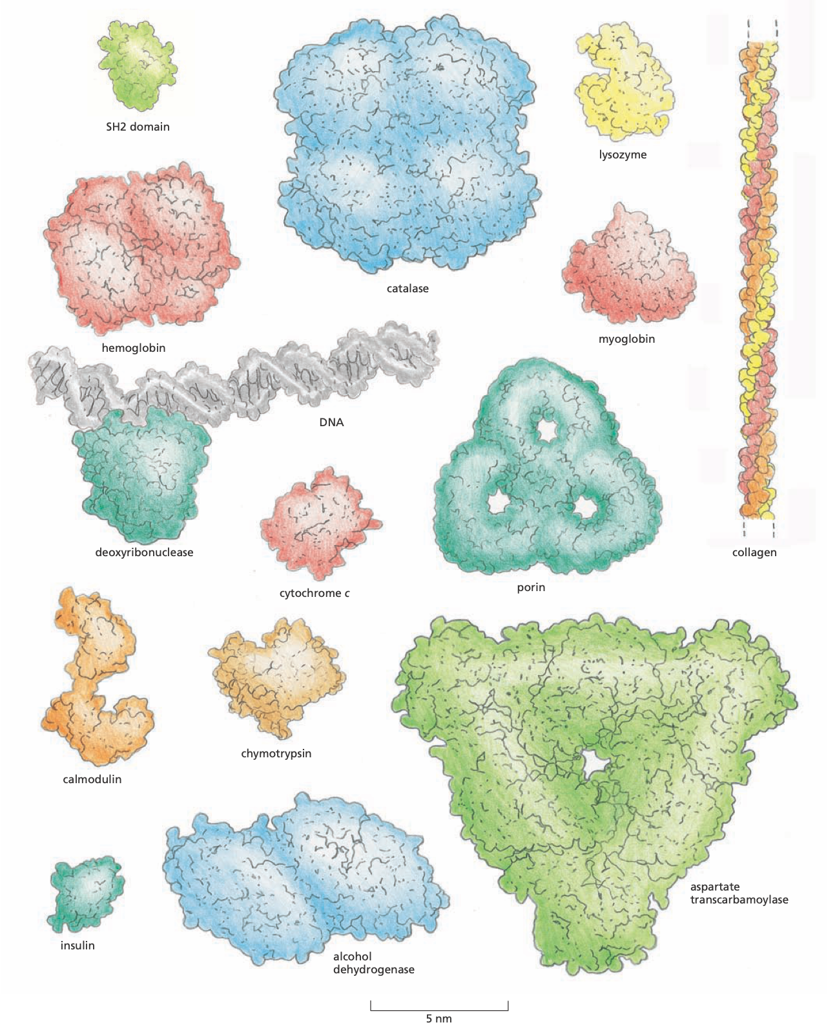
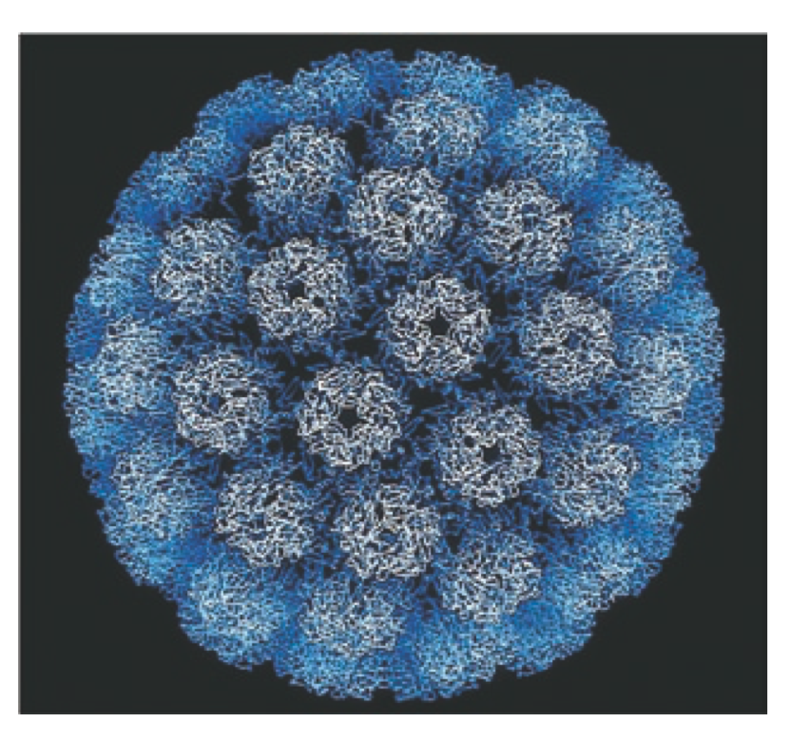
Shapes and Sizes

Slide 6
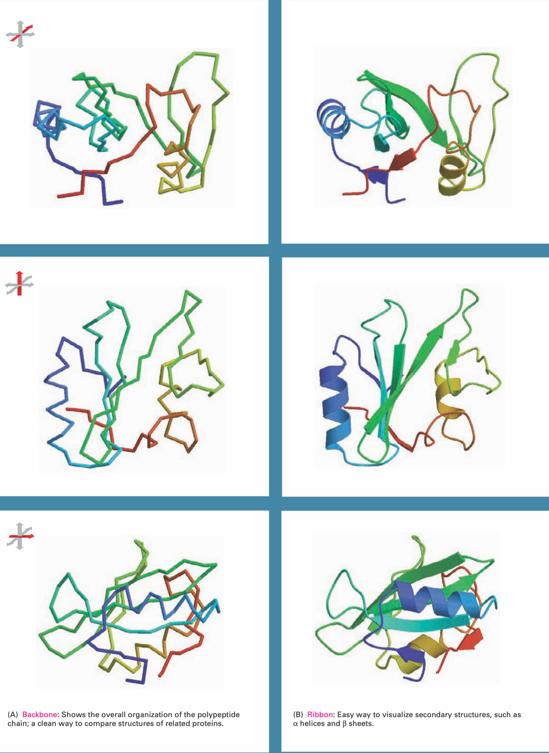
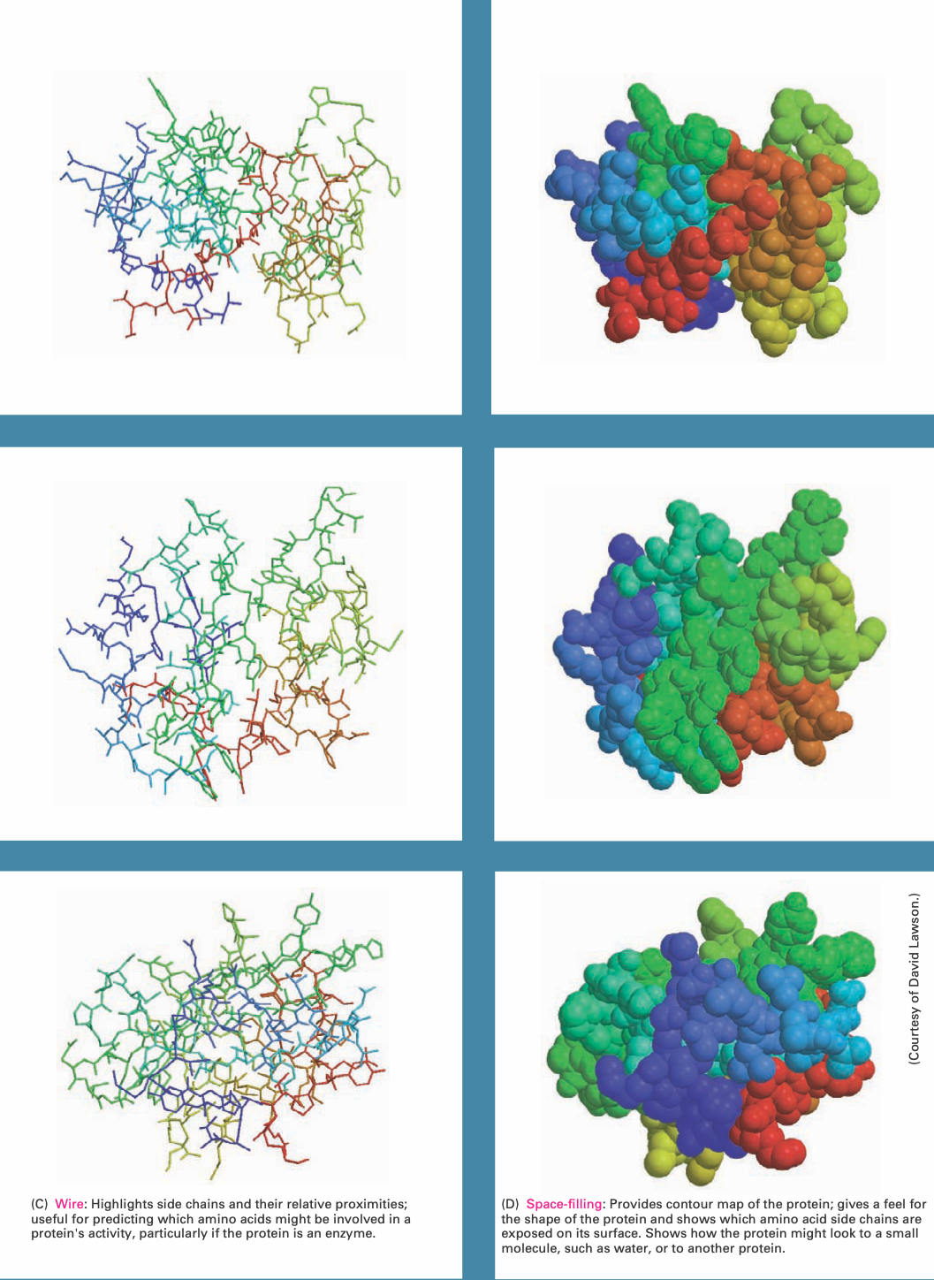
Views of Proteins

Slide 7
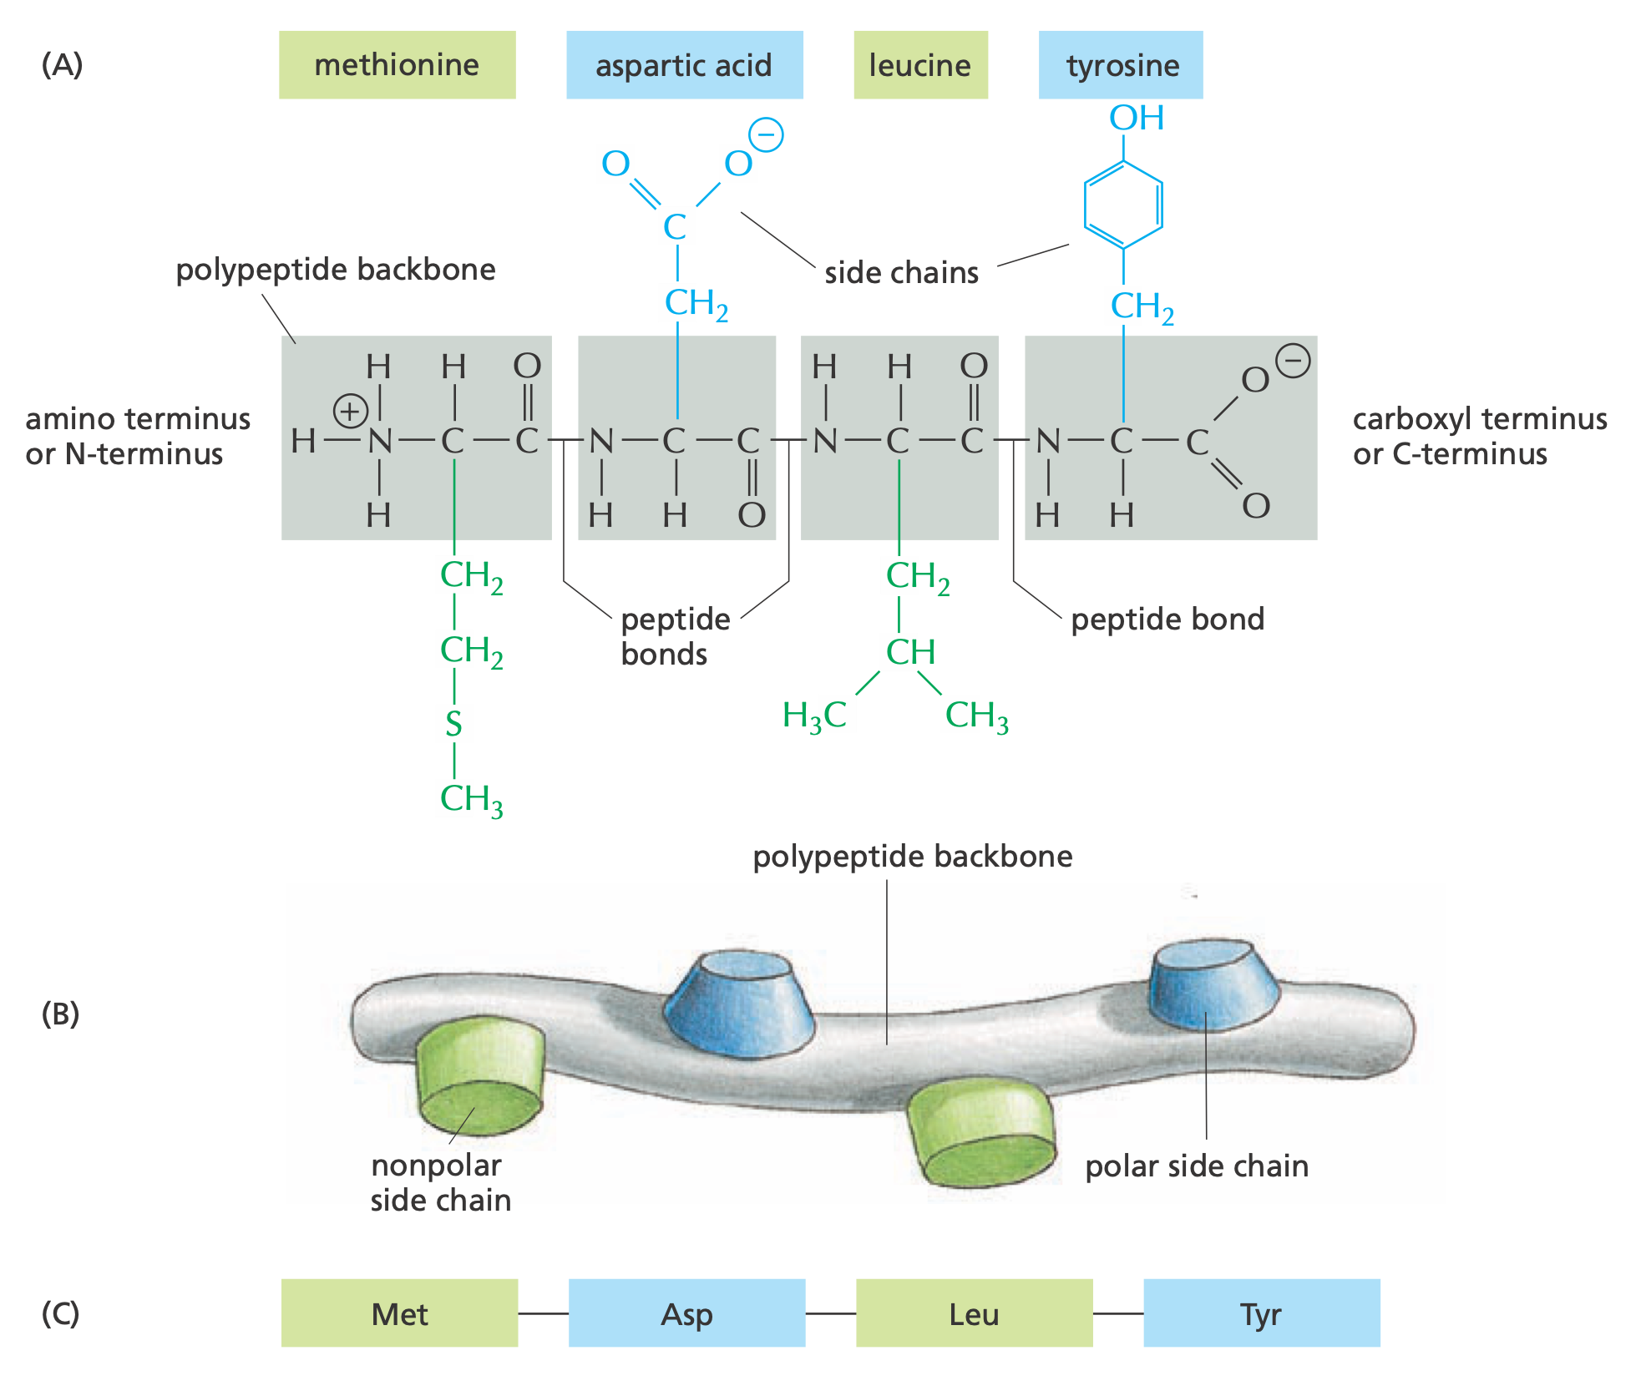
Protein Structure

Slide 8
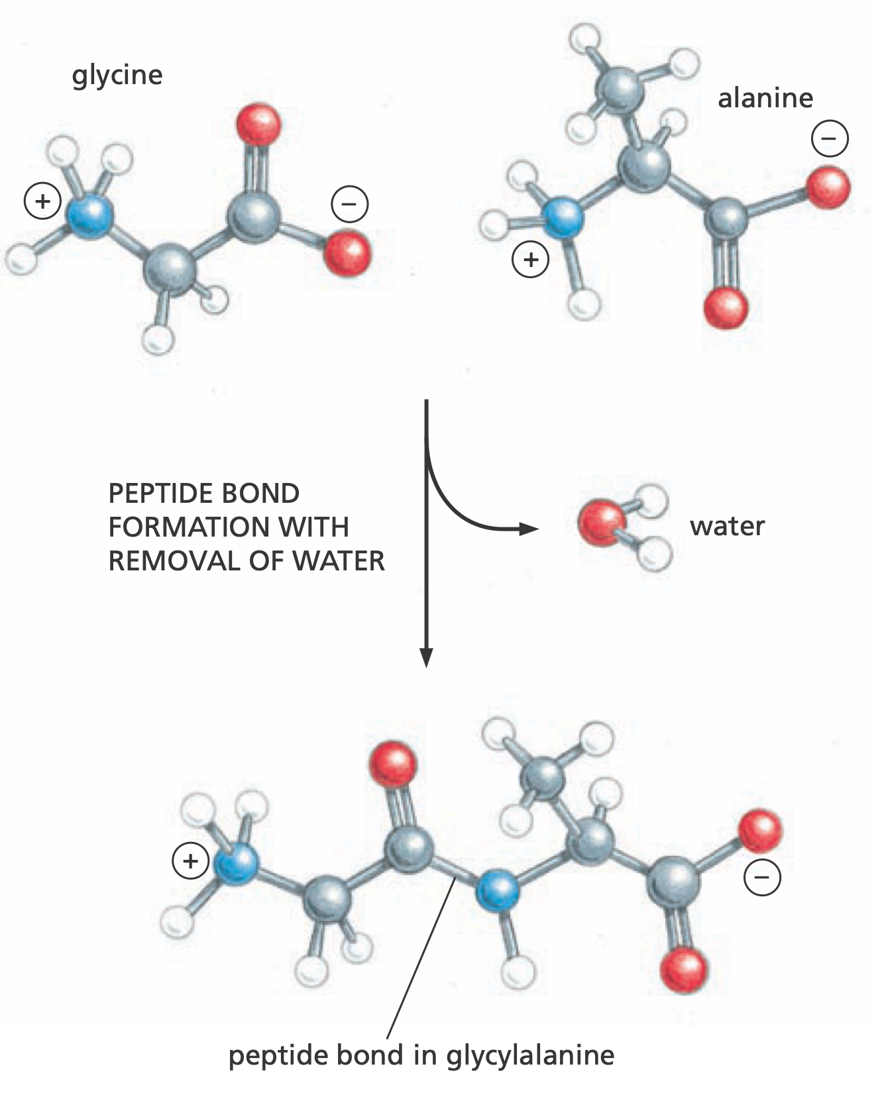
Peptide Formation

Slide 9
Amino Acids
wikimedia.org

Slide 10
Protein Structures
wikimedia.org

Slide 11
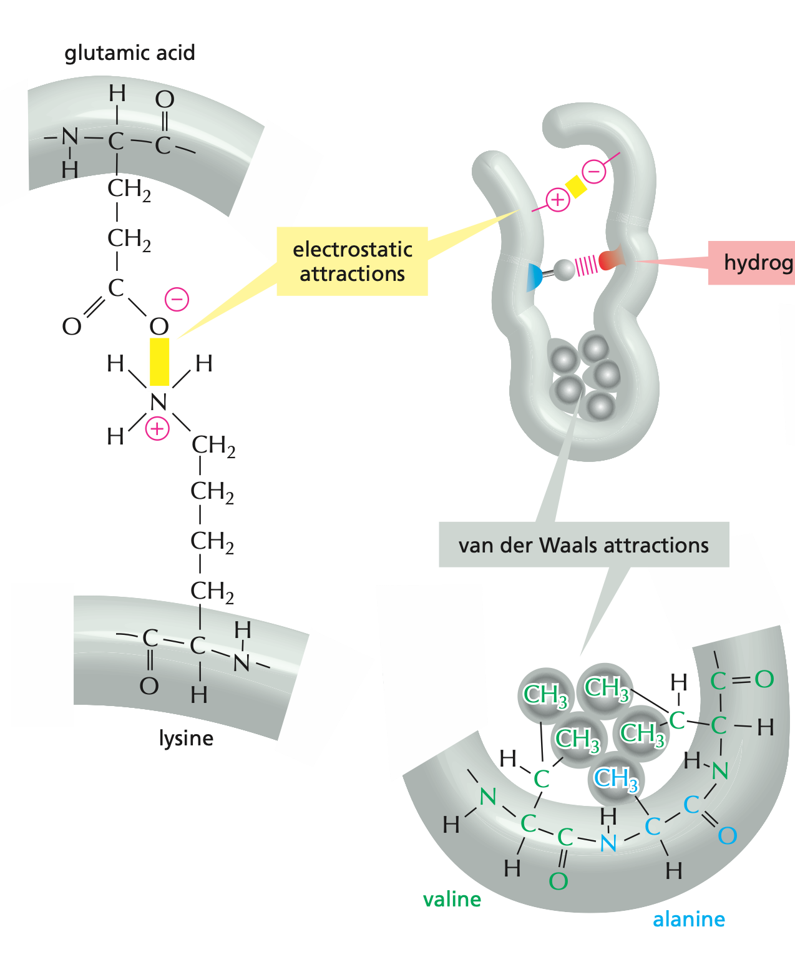
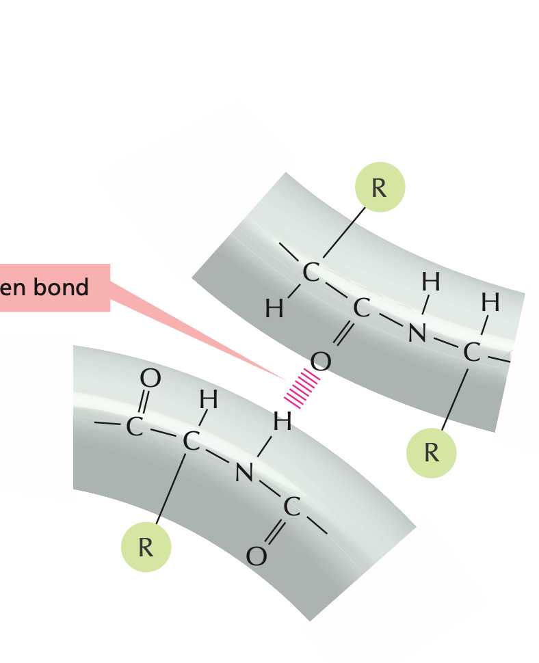
Non-covalent Bons

Slide 12
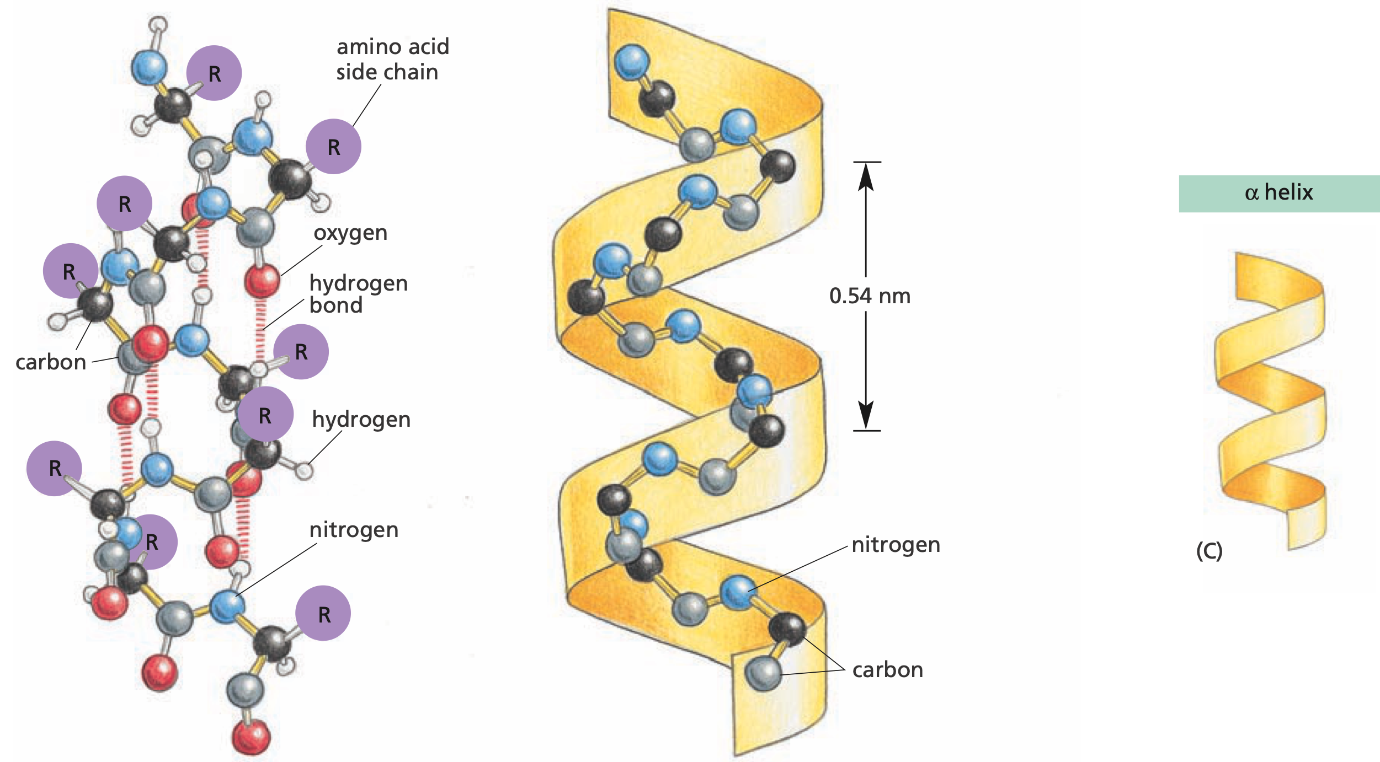
ɑ-Helix

Slide 13
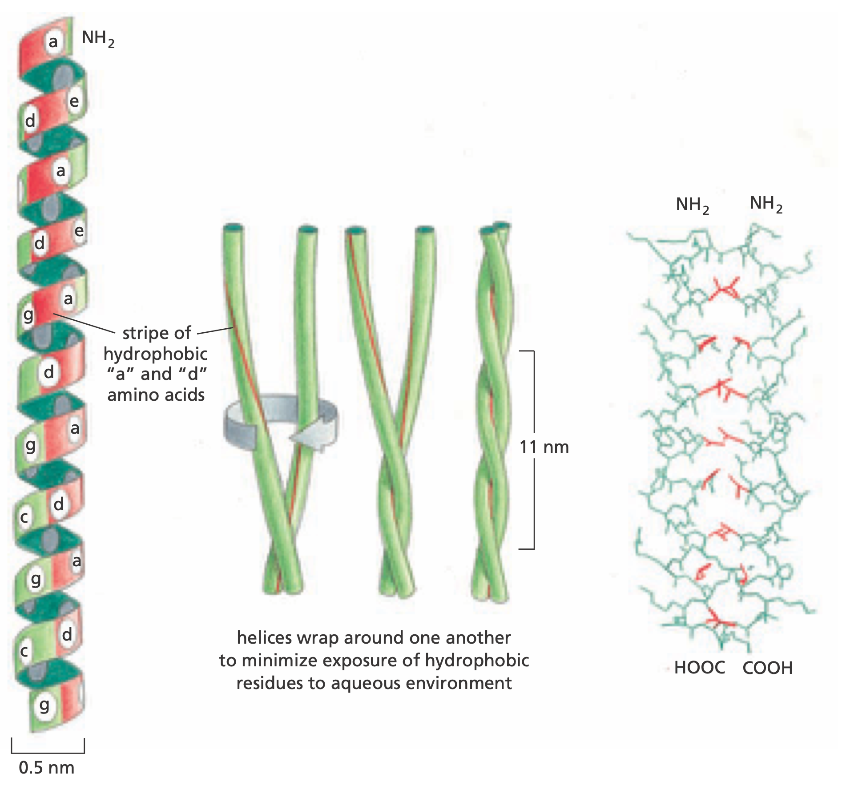
Coiled-coil Helices

Slide 14
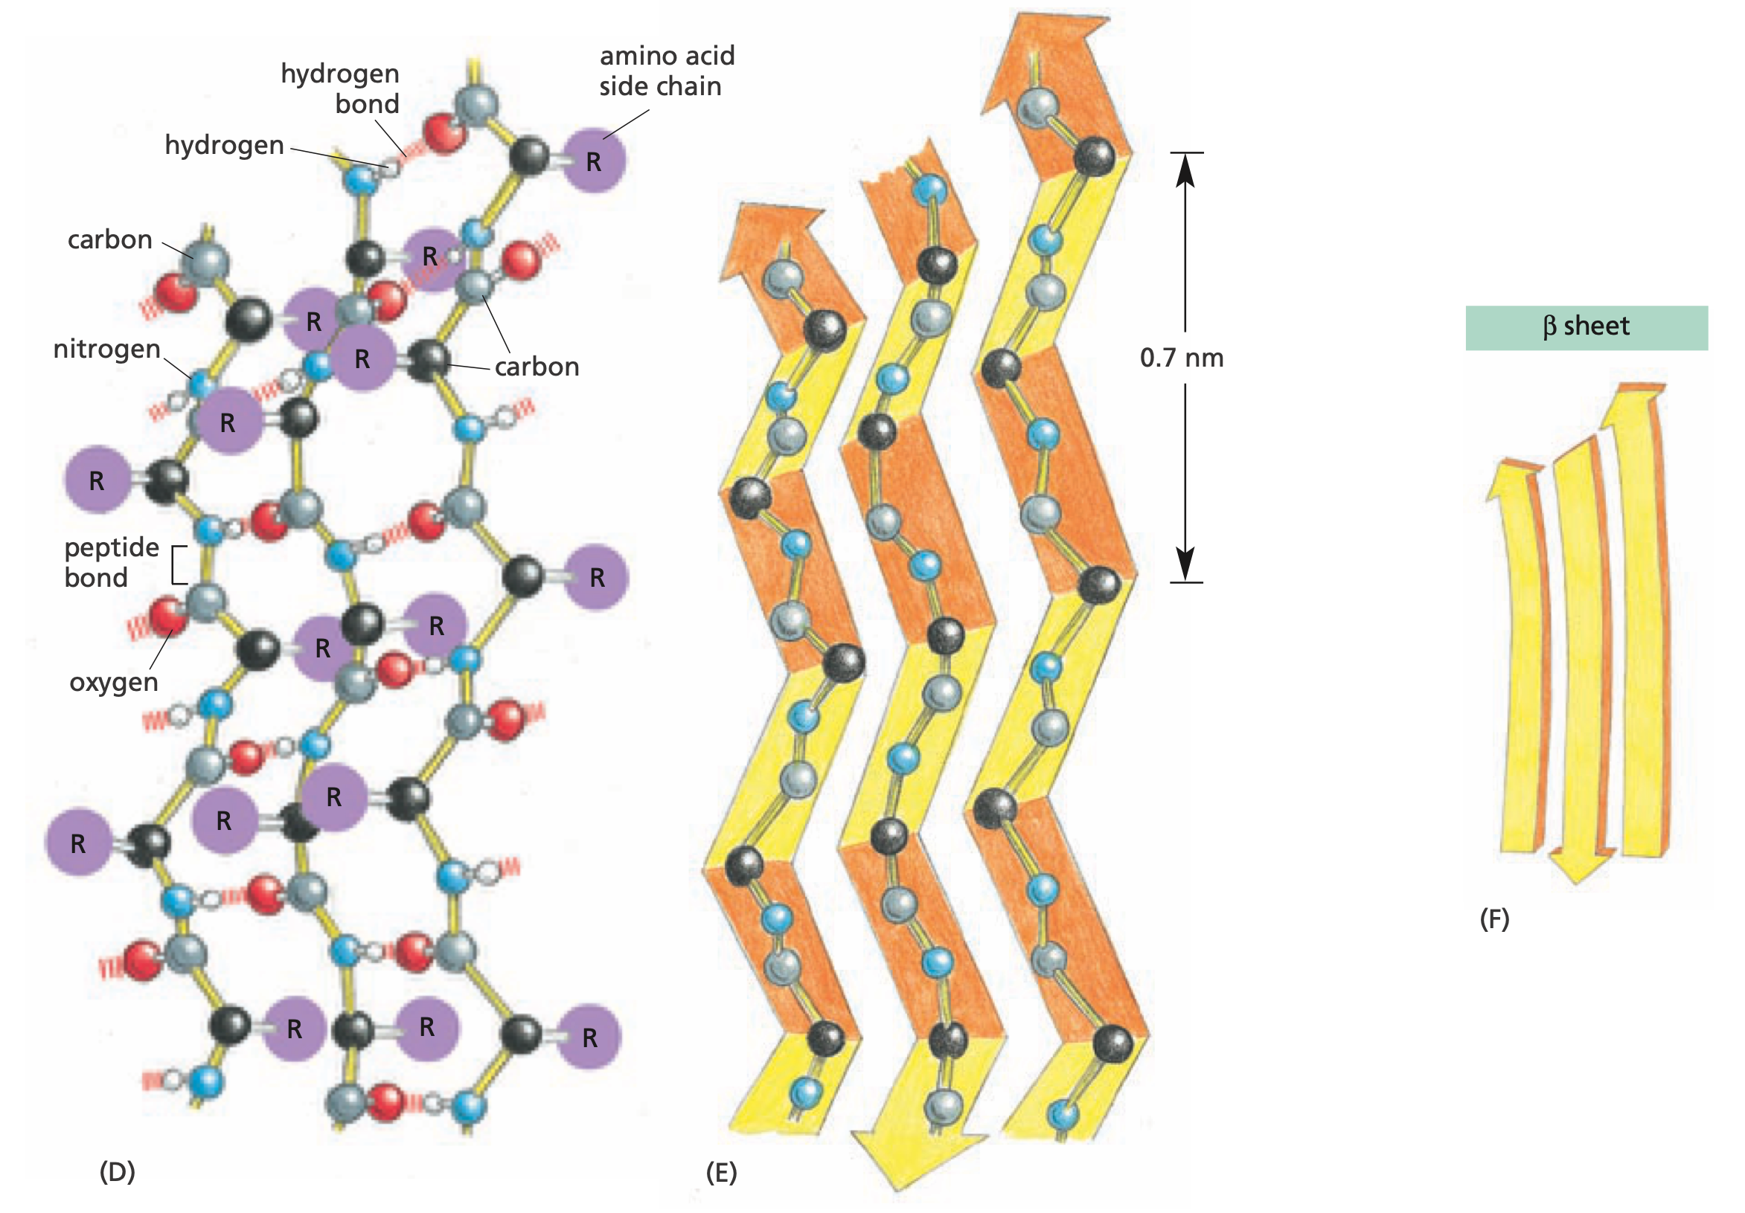
β-Sheet

Slide 15
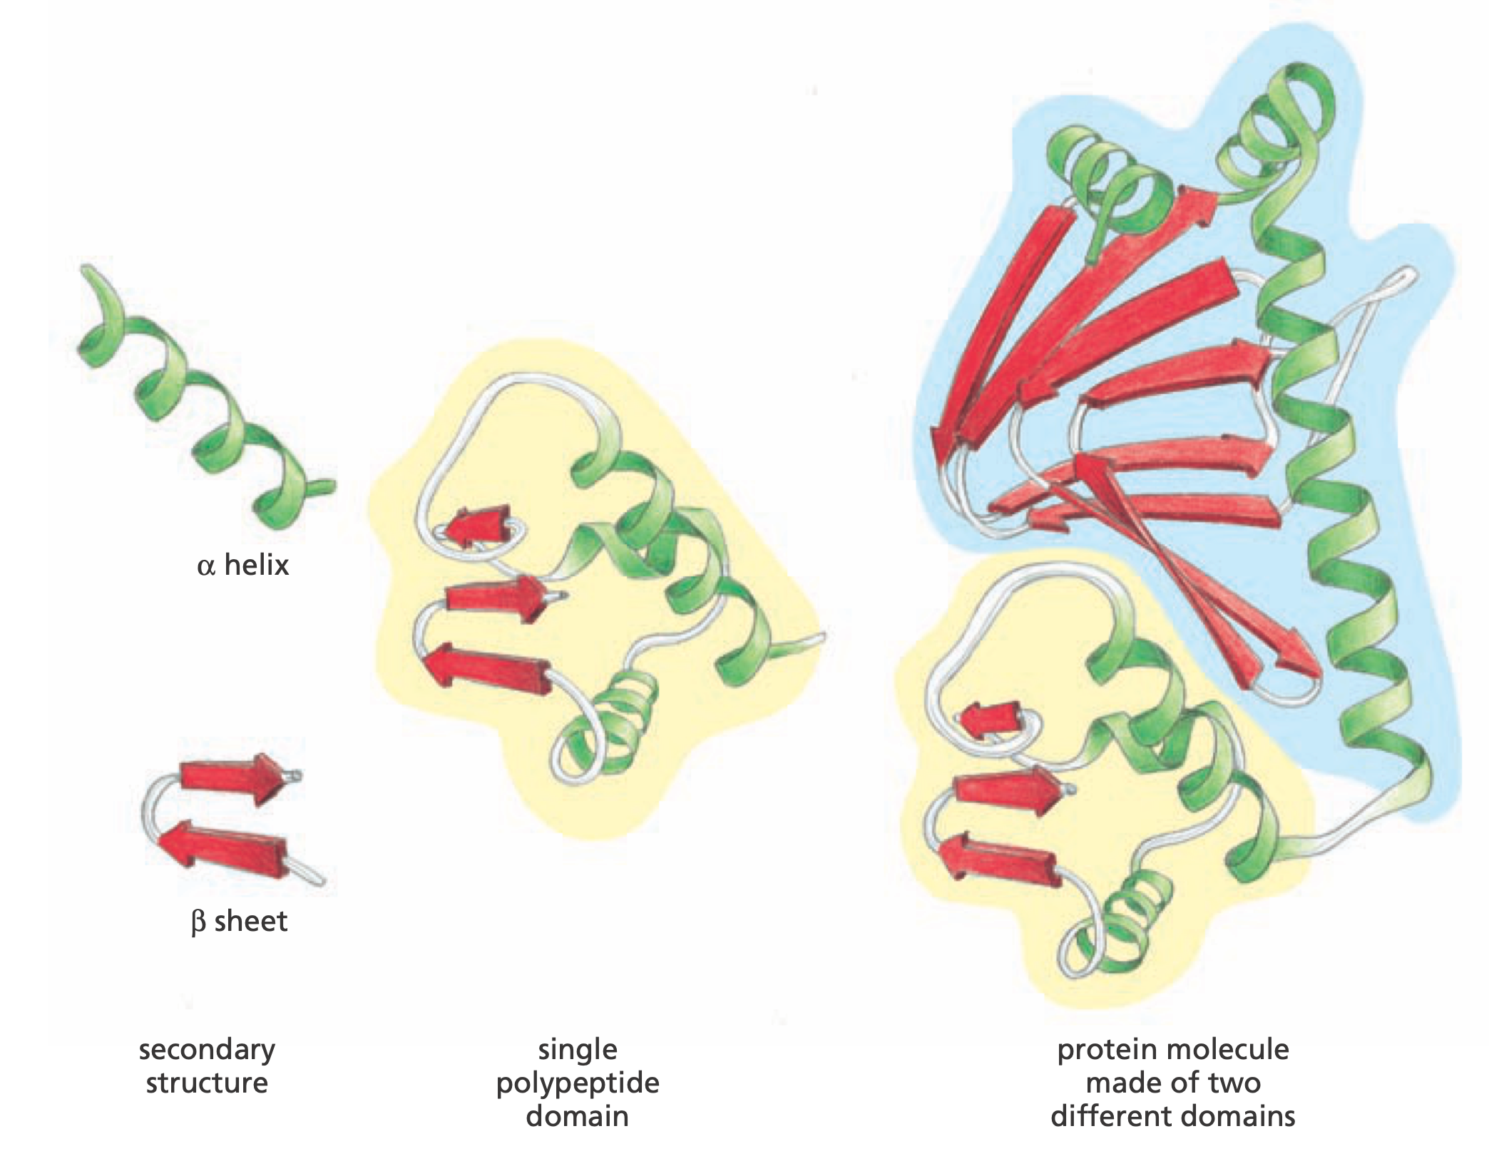
Different Structures

Slide 16
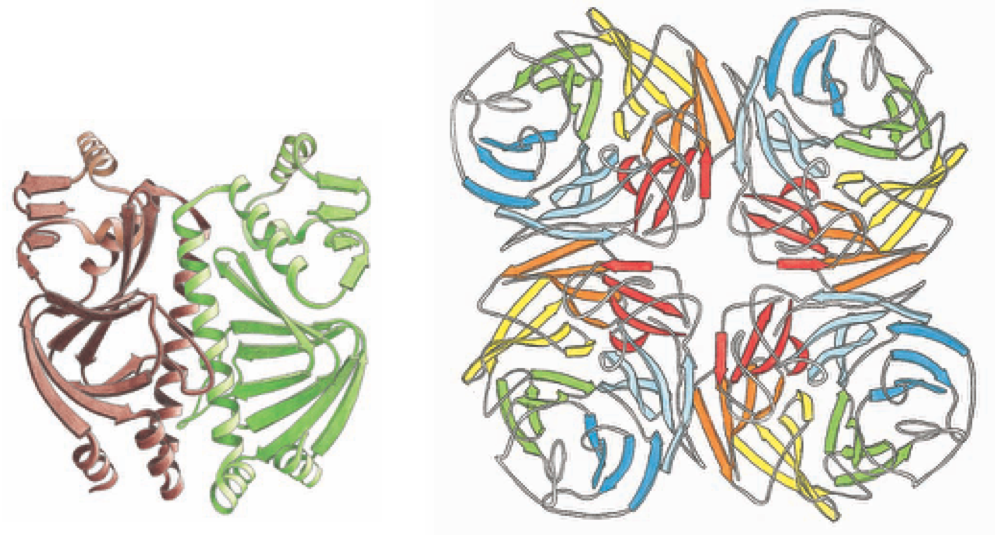
Repeated Units

Slide 17
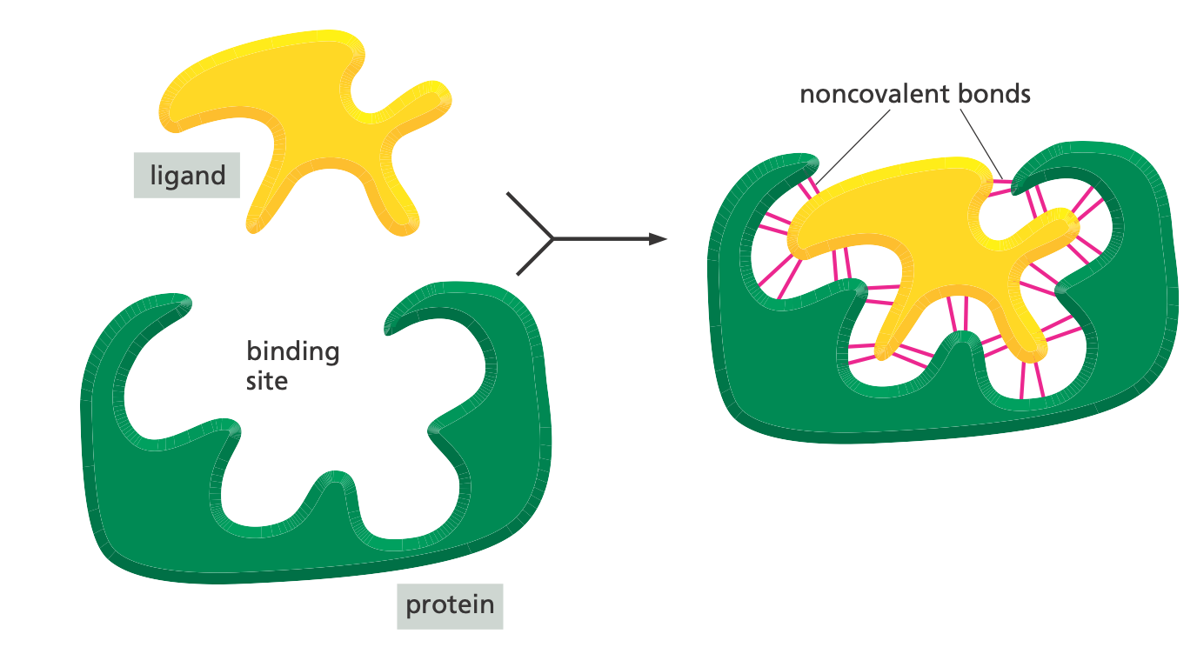
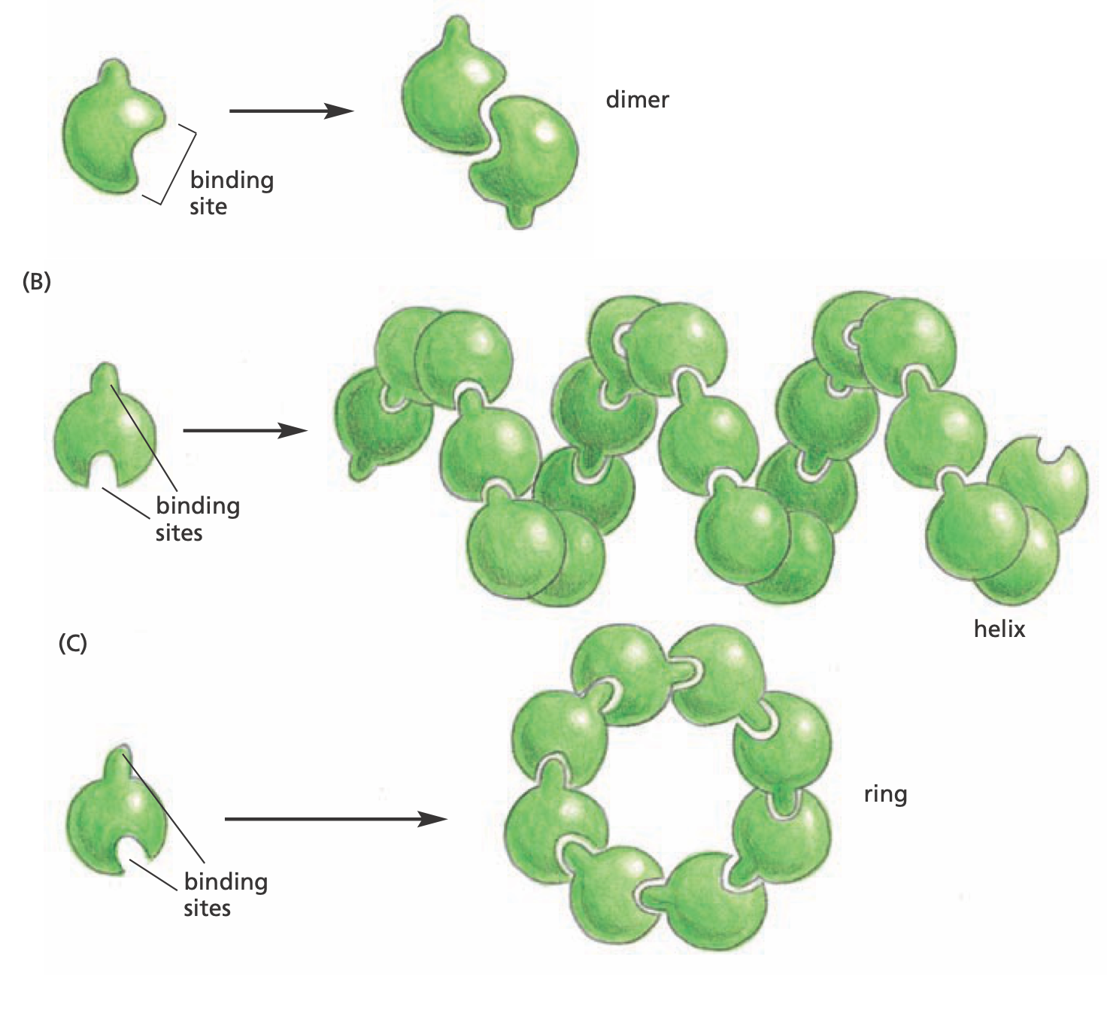
Protein Binding

Slide 18
Many Different Shapes
wikimedia.org

Slide 19
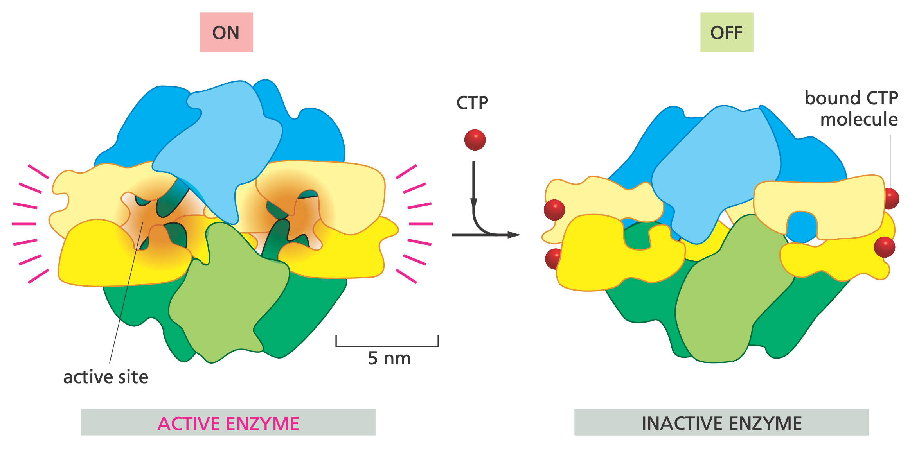
Proteins go On and Off
Notes:
cytosine triphosphate (CTP)

